Slide 1
Intro to JavaScript

Slide 2
Introduction
What is JavaScript?
Programming language (as opposed to a markup or stylesheet language)
Runs in your browser (also called a client)
Transforms static web pages to dynamic documents that change at your will

Slide 3
Introduction
Why use JavaScript?
One of the most popular and in demand programming languages in the world
Vast, supportive community of millions of developers
One of the foundational technologies of the internet

Slide 4
Introduction
JavaScript is not Java
Java is a server-side Object Oriented programming language
JavaScript is a client-side Scripting language

Slide 5
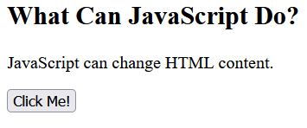
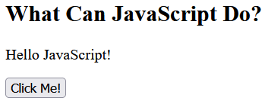

JavaScript Can Change HTML Content
One of many JavaScript’s HTML methods is getElementById()
This example finds an HTML element with an ID of “demo” and changes the element’s content (innerHTML) to “Hello JavaScript”

Slide 6
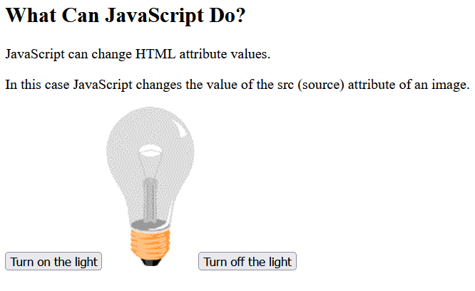
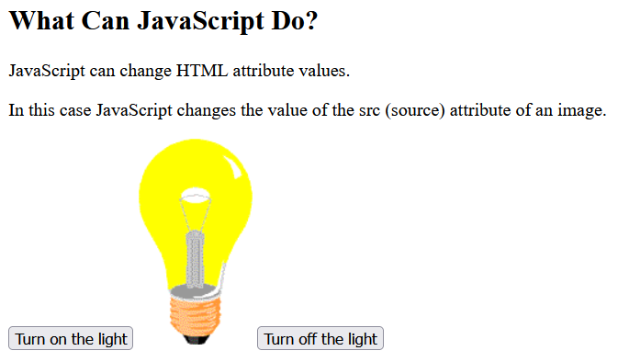
JavaScript Can Change Attribute Values
The following example shows JavaScript change the src attribute of an <img> element

Slide 7
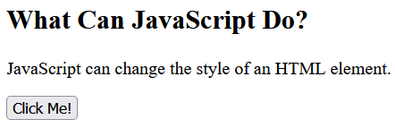
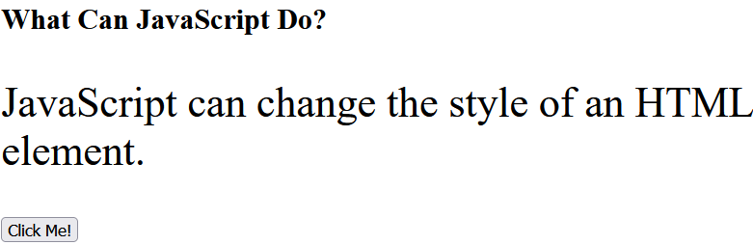
JavaScript Can Change CSS
Changing the style of an element is a variant of changing an HTML attribute

Slide 8
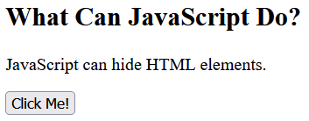
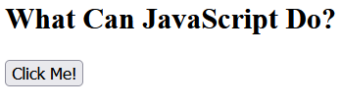
JavaScript Can Hide HTML Elements
Hiding HTML elements can be done by changing the display style

Slide 9
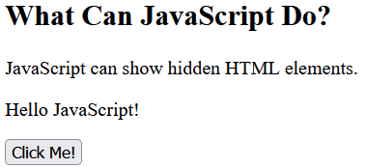
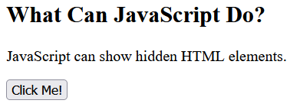
JavaScript Can Show HTML Elements
JavaScript can show elements that had been hidden by changing the display style as well

Slide 10
JS Where To

Slide 11
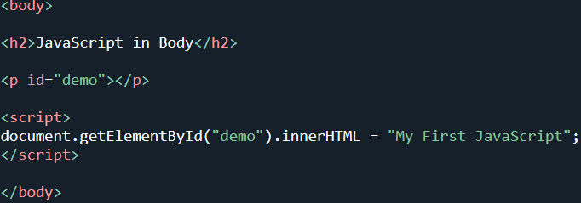


The <script> Tag
In HTML, JavaScript code is inserted between the opening and closing tag of the <script> element

Slide 12
JavaScript in the Head or Body
You can place as many scripts as you would like in an HTML document
Scripts can be placed in the <body>, the <head>, or in both
It’s a best practice to place your scripts at the bottom of the <body> element

Slide 13
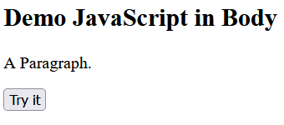
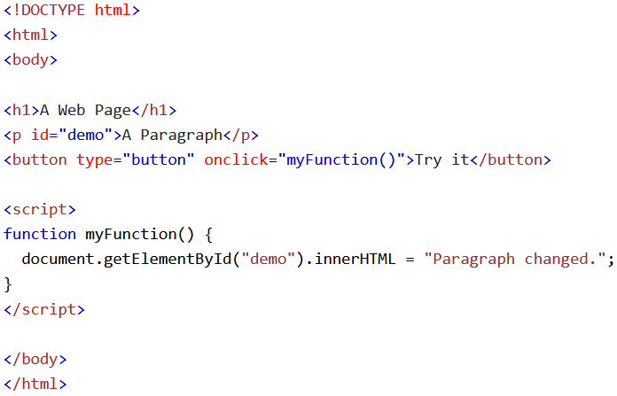
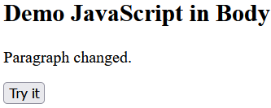

JavaScript in the <body>
In this example, a JavaScript function is placed in the <body> section of an HTML page
The function is invoked, or called, when the button gets clicked

Slide 14

External JavaScript
Scripts can and generally should be placed in external files, just like with CSS
Every JavaScript file has the file extension .js
To use an external script, put the name of the script file in the src attribute of a <script> tag

Slide 15

External JavaScript Advantages
External scripts separate HTML and our code (separation of concerns)
It makes HTML and JS easier to read and maintain
Cached JS files speed up the time to load your webpage

Slide 16

External References
External scripts can be referenced with a full URL or with a relative path to the current web page

Slide 17
JS Output

Slide 18

Output
JS has 4 general types of output
Alerts
Pop Ups
Into an HTML Element via innerHTML
Main form of output
Into HTML Output via document.write()
Generally only for testing
Console
Generally only for testing

Slide 19
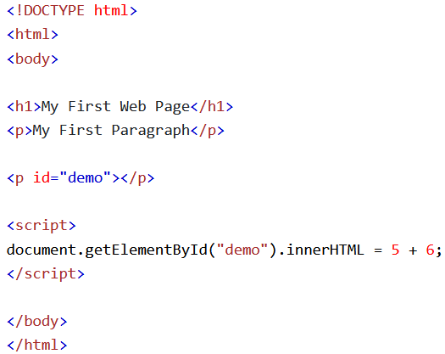
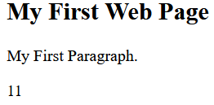

Using innerHTML
To access an HTML element, JavaScript can use the document.getElementById(id) method
The id attribute defines the HTML element
The innerHTML property defines the HTML content

Slide 20
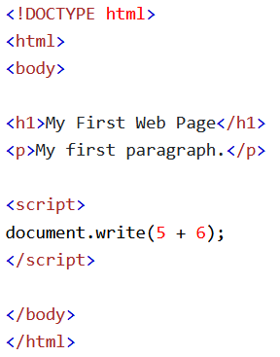
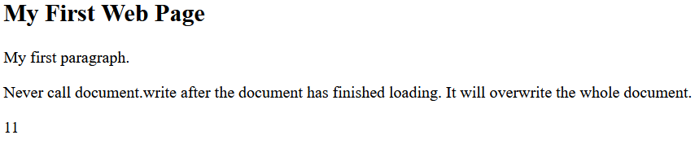
Using document.write()
For testing purposes, it is convenient to use document.write()
Warning: using document.write() removes all other HTML from a webpage, so only the content you used document.write() on will remain
This is intended for testing purposes

Slide 21
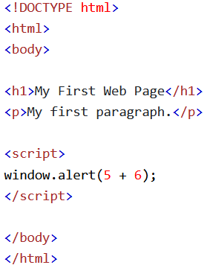
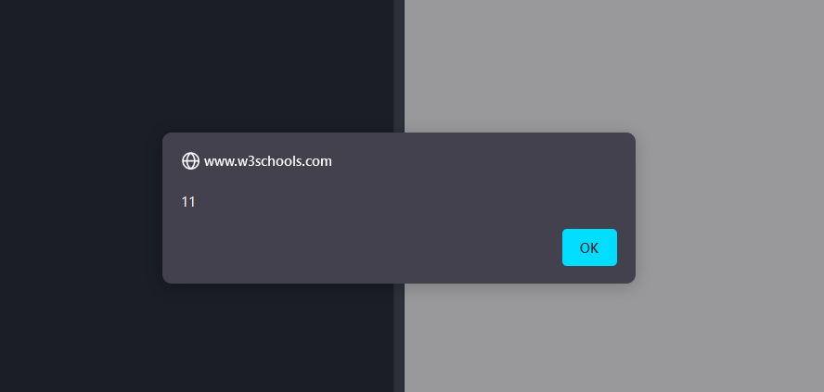
Using window.alert()
Using window.alert(), or alert() for short, creates a popup box

Slide 22
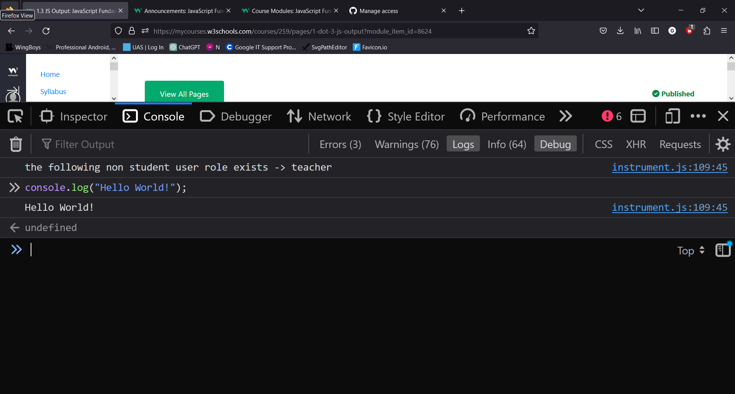
Using console.log()
You can use console.log() to run JavaScript commands in the console of your browser’s DevTools
console.log() is extremely useful for testing purposes and is the reason the console is so helpful
Using console.log() is often referred to as “logging” or “printing”

Slide 23
JS Statements

Slide 24
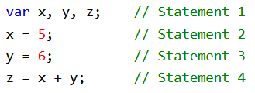

JavaScript Programs
A computer program is a list of “instructions” to be “executed” by the computer
In a programming language, these instructions are called statements
A JavaScript Program is a list of programming statements

Slide 25
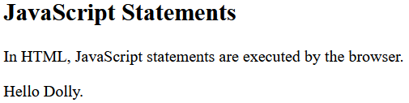
JavaScript Statements
JavaScript statements are composed of values, operators, expressions, keywords, and comments
Most JS programs contain many JS Statements
The statements are executed, one by one, in the same order as they are written

Slide 26
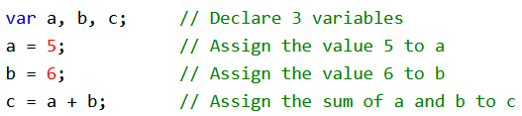
Semicolons ;
Semicolons separate JavaScript statements
Add a semicolon at the end of each executable statement

Slide 27


Semicolons ;
When separated by semicolons, multiple statements can be written on the same line
Unlike other programming languages, semicolons are technically not required
However, you should include the semicolon at the end of each line anyway to avoid causing issues down the road

Slide 28

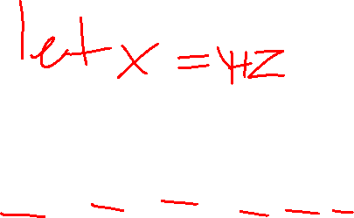
White Space
JavaScript ignores multiple spaces
Whitespaces can be added to make your scripts more readable
It is a best practice to put spaces between every variable, keyword, and operator

Slide 29


Line Lengths and Line Breaks
For readability, try to keep your lines of code to 80 characters or less
If a statement does not fit on a single line, you can break it into two lines by hitting enter.
You should break your lines after an operator

Slide 30
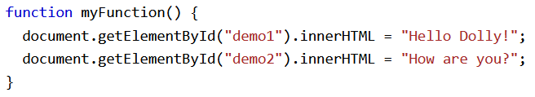
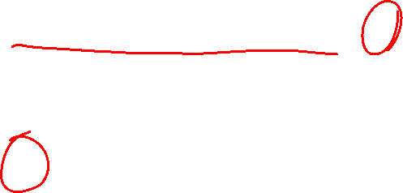
JavaScript Code Blocks
JavaScript statements can be grouped together in code blocks, inside curly brackets { … }
The purpose of code blocks is to define statements to be executed together
An example of this is with JS functions

Slide 31
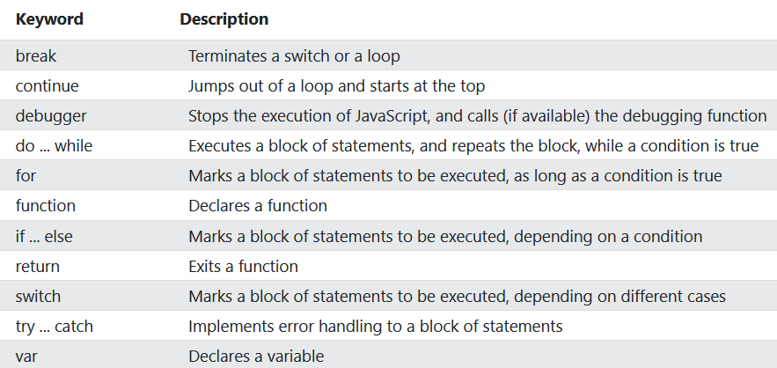

Keywords
JS statements often begin with a keyword to identify the action to be performed
Here is a list of some of the keywords you will learn about:

Slide 32
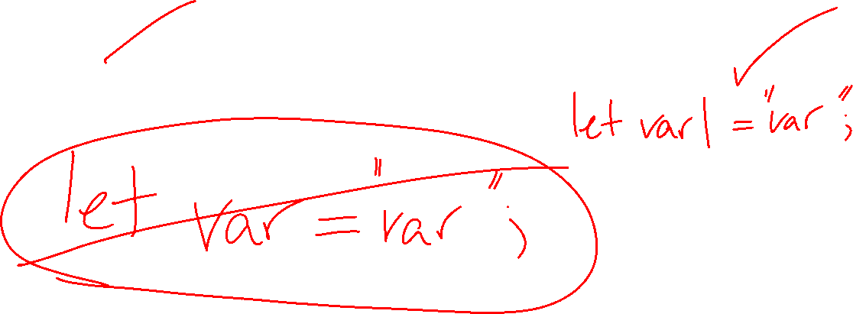
Keywords
JS statements generally start with a keyword
Keywords are reserved words for use by JavaScript
Ex: let, var, const, try, catch, finally, if, else
You cannot use these when naming – JS will throw an error
Your IDE will highlight these words for you

Slide 33
Syntax

Slide 34
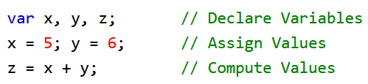
Syntax
JS syntax is the set of rules for how JS programs are constructed

Slide 35

Values
There are 2 types of values
Literal – a constant value
Ex: 10, “hello world”, true
Variable – value that has been stored for later use
These work the same way they do in Algebra (but much more friendly!)
Ex: let doodle = “doodle”;
const thisIsAVariable = 50;

Slide 36



Operators
JS uses arithmetic operators (+, -, *, /) to compute values
JS uses an assignment operator (=) to assign values to variables

Slide 37
Expressions
An expression is a combination of values, variables, and operators, which compute to a value
The computation is called an evaluation
Ex: 5 * 10 evaluates to 50

Slide 38


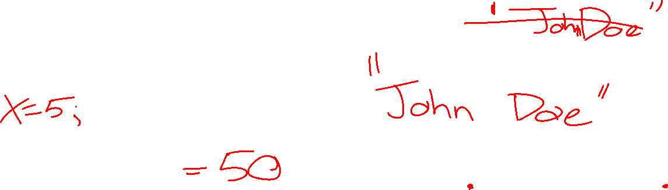
Expressions
Expressions can also contain variable values
The values can be of various types, such as numbers and strings
For example, “John” + “ “ + “Doe” evaluates to “John Doe”

Slide 39
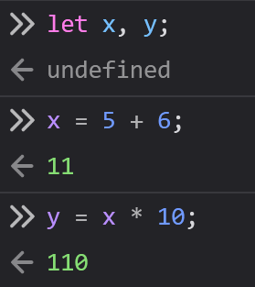
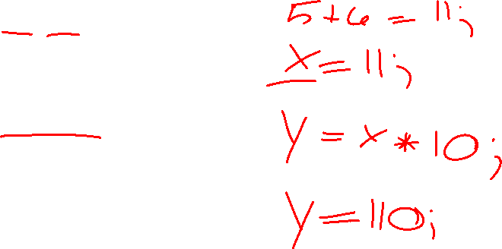
Keywords
JavaScript keywords are used to identify actions to be performed
The let keywords tells the browser to create variables

Slide 40
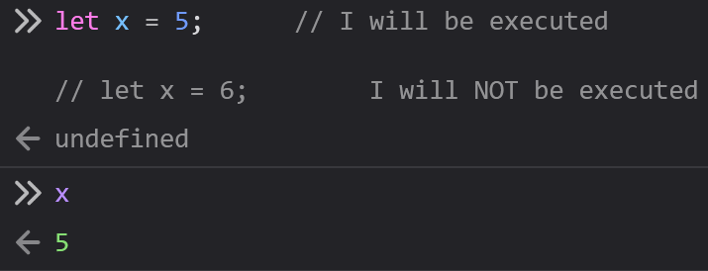
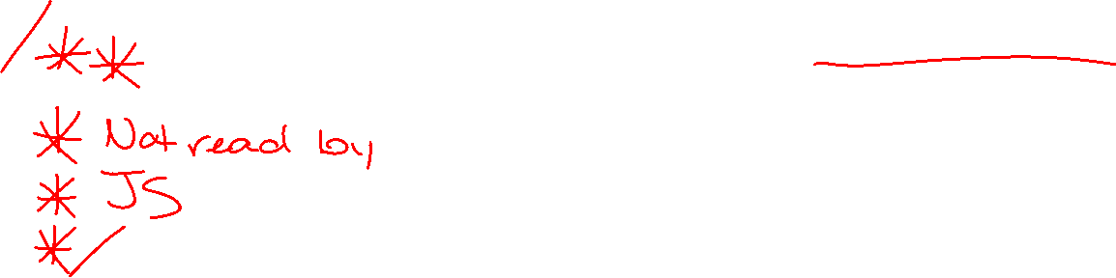
Comments
Not all expressions are “executed”
Code after double slashes // or between /* and */ is treated as a comment
Comments are ignored by JavaScript and serve as messages for other programmers or as a debugging tool

Slide 41
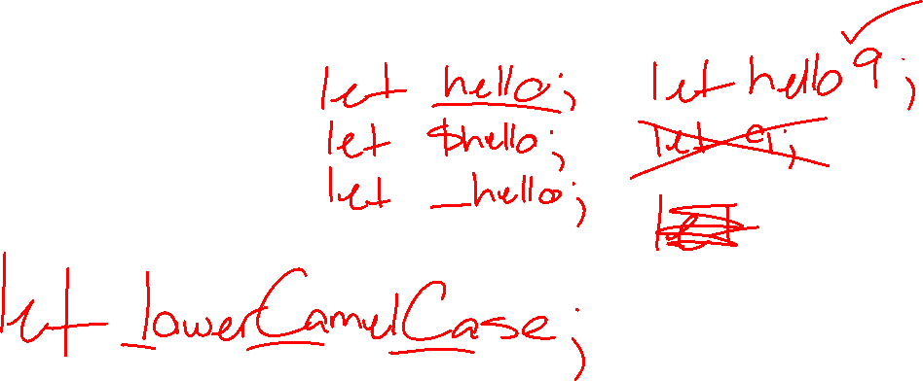
Naming Conventions
JavaScript uses lowerCamelCase when naming variables and functions
Names may begin with
A letter
A dollar sign ($)
An underscore (_)

Slide 42
Naming Conventions
All names are case sensitive
Ex: let variable; and let Variable; creates two different variables, despite the same name

